Slide 1
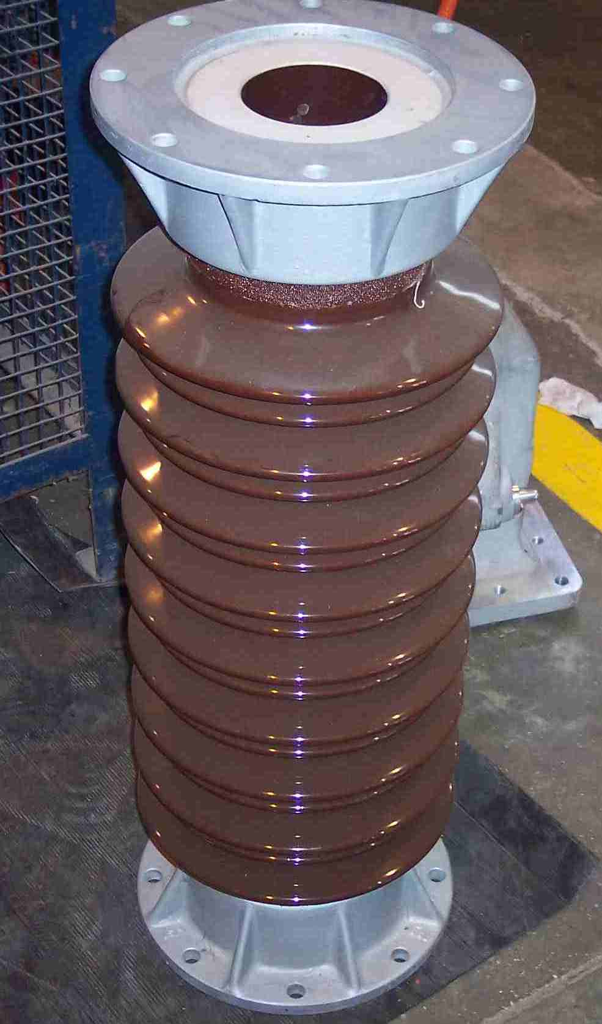
SIEMENS
HVCB SPARES
Support Insulator
72.5KV, 40KA CB
S4901880749

